Slide 1
How big are cells?
Nerve cell from a giraffes neck - 3m
Human kidney - 13cm
Human egg - 100µm
Sperm cell - 55µm
Cilia - 10µm
Red blood cell - 9µm
Mitochondrion - 2µm
HIV virus - 100nm
Ribosome - 20nm
Units for measurements
Millimeters - mm
Micrometers - µm
Nanometers – nm
1mm = 1000µm
1µm = 1000nm

Slide 2
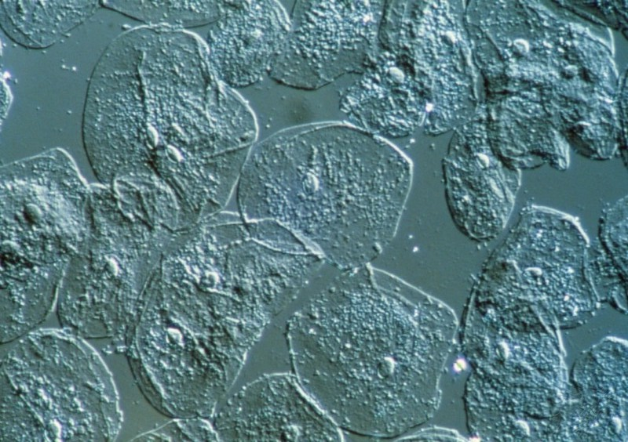
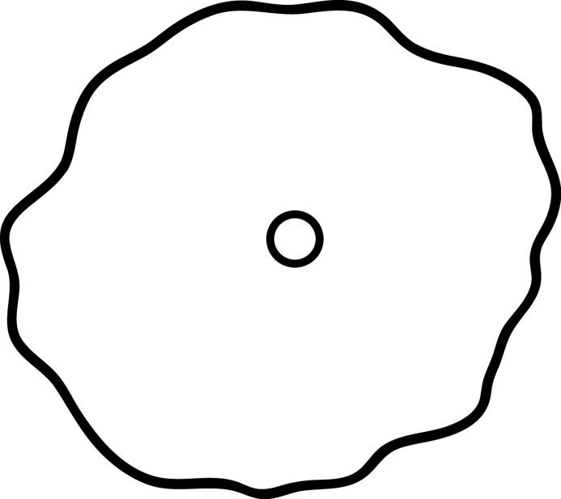
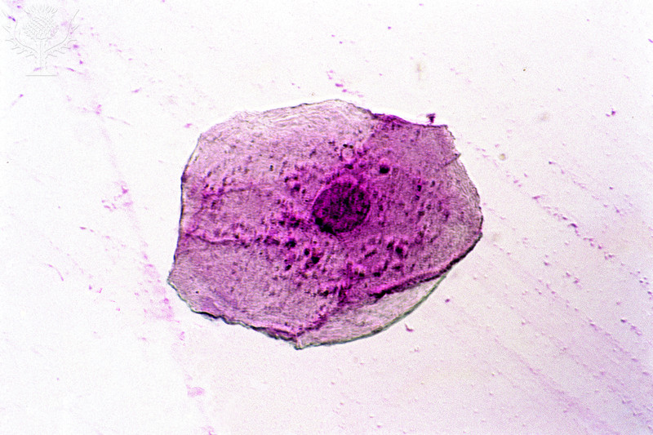
How big are cells?
plasma membrane
Approximately 60µm in diameter
Cheek cell
cytoplasm
nucleus

Slide 3
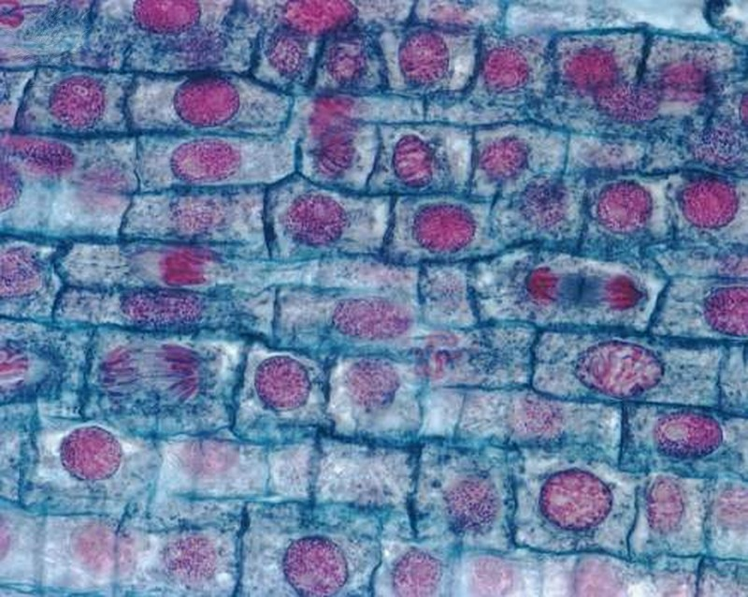
How big are cells?
Onion cells
Approximately 200µm in diameter

Slide 4
To see more detail an electron microscope can be used
Electron microscopes use an electron beam instead of light, which is focussed using electromagnets.
The specimen has to be specially prepared and held inside a vacuum chamber from which the air has been pumped out (because electrons do not travel very far in air).
The image is formed as a photograph (called an electron micrograph) or as an image on a TV screen.

Slide 5
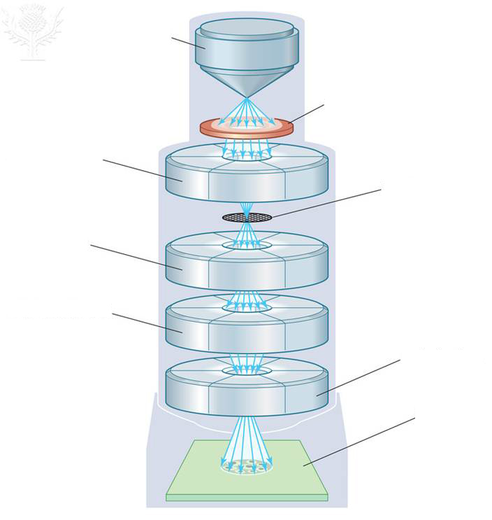
Electron microscope
high voltage
electron gun
Specimen is dead and dehydrated.
Black and white image [or false colour].
Objects can be magnified up to x500000!
anode
condenser lens
objective aperture lens
specimen
Intermediate
lens
projector lens
fluorescent screen

Slide 6
Comparing light and electron microscope
 | Light microscope | Electron microscope
Magnification | x1500 | X500,000
Resolution | 250nm | 0.25nm
Type of radiation used | Light | Electrons
Focussed by | Glass lenses | Electromagnets
Type of material that can be viewed | Living/moving/dead/abiotic | Dead/abiotic
Size | Small and portable | Large and static
Preparation and cost of material | Cheap and easy | Difficult and expensive

Slide 7
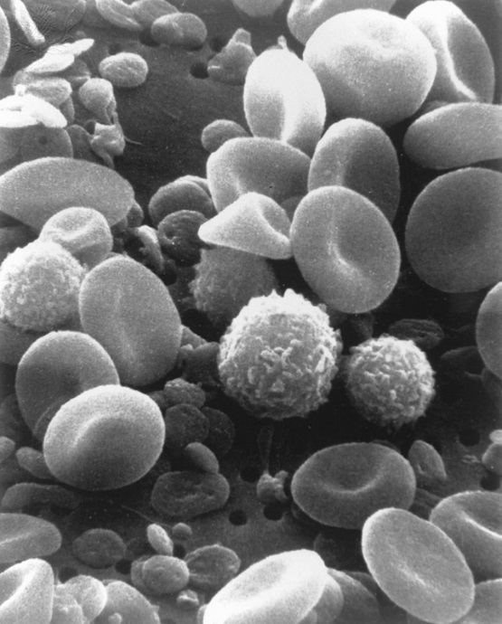
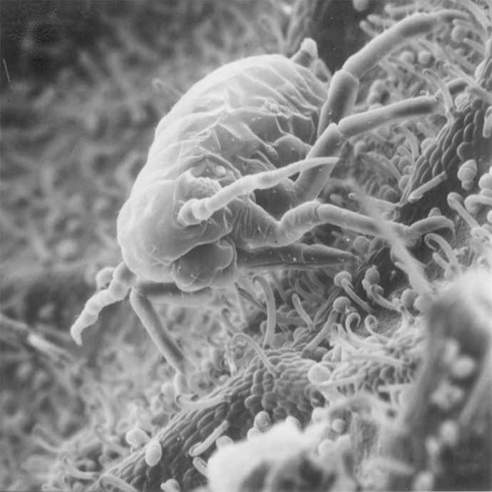
Scanning Electron Microscope (SEM)
Work in a similar way like Transmission Electron Microscope (TEM)but are designed to make images of the surfaces of objects.

